Slide 1
Initial Project Evaluation: Phase-||
Submitted by:
Paavana M : 01JST17CS103
Sona Agrawal : 01JST17CS
Vishak S: 01JST17CS103
Yashwanth H L: 01JST17CS

Slide 2
Three main parts of project:
UI
Data Processing using ML algo
Backend

Slide 3
User Interface
IDE used: Visual Studio Code
Language used: JavaScript, Html, CSS
Framework used: React Js

Slide 4
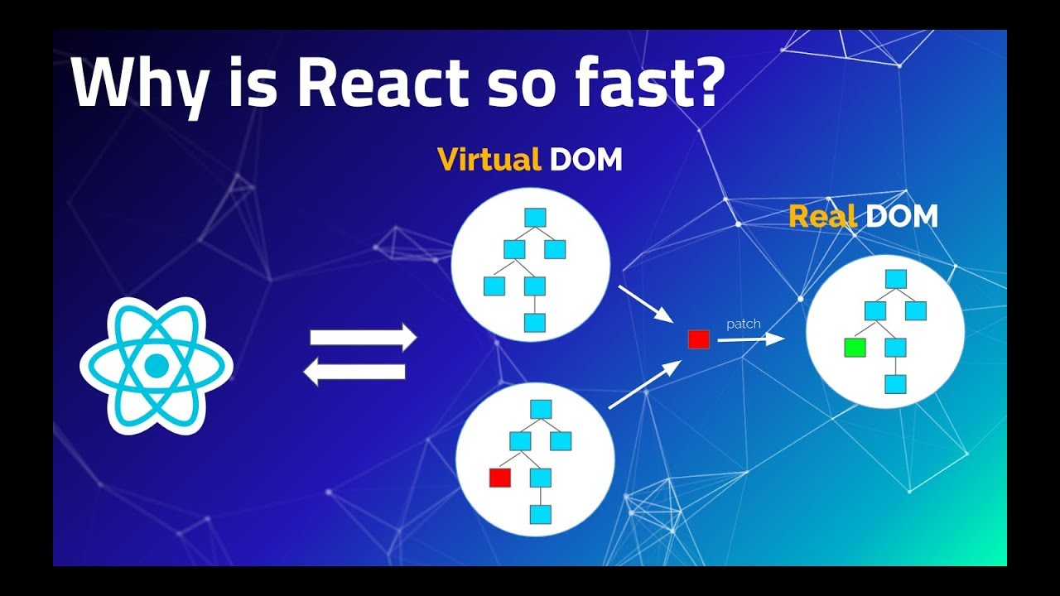
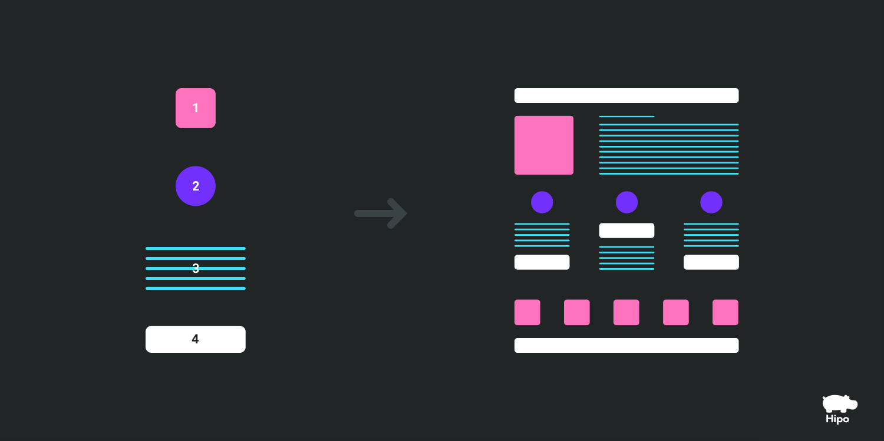
Why React?
Working with huge dataset demands high speed.
Virtual DOM
Components
Client-side computation
Advanced libraries

Slide 5
Specific Packages
Axios: for connecting to the server
Canvas: for creating a drawing board effect
Progress :
Login
Register
Canvas

Slide 6
Next Aim:
Improve validations
Better structure with Linking of components
Connect to the server with a connection string
Compress the drawn image to some format and send it to the server for further processing

Slide 7
Data Processing

